Slide 1
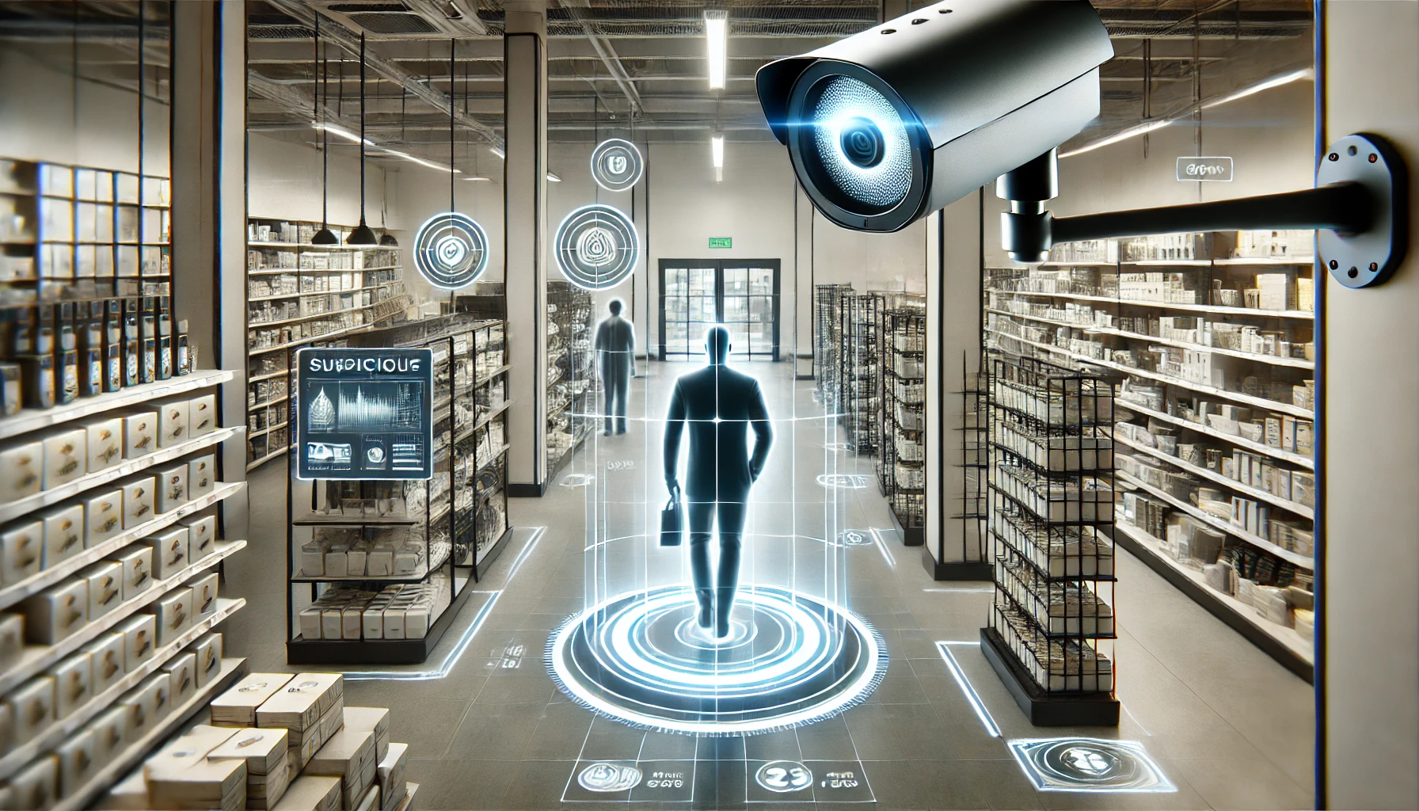
Shoplifting Detection
This project tackles shoplifting by using machine learning to detect suspicious behavior
in real-time through video analytics. The ML models(Convolutional LSTM) enhance security by automating theft detection, improving response times, and reducing incidents. Continuous model updates ensure accuracy, fostering a safer shopping environment.
Group -3
Guide-Mrs. Gargi Singh
Members: Avadhesh Kumar Prajapati
Ayushi Chouhan

Slide 2
Project Abstract
Overview
Key Objectives
Approach
Integrate machine learning for real-time shoplifting detection.
Enhance surveillance with AI-driven video analytics.
Implement data-driven theft prevention strategies
The ML approach focuses on training models to analyze video footage and detect suspicious behavior, such as unusual movements or actions indicative of shoplifting. These models will be continuously improved using labeled data to increase accuracy. Real-time predictions will trigger alerts, allowing for quick responses to potential theft.
This project tackles shoplifting using machine learning models(Convolutional LSTM) to enhance security, improve surveillance, and prevent theft. It focuses on leveraging AI to identify suspicious behavior, streamline security systems, and reduce shoplifting incidents

Slide 3

Project Goals and Objectives
Project Goal: To reduce shoplifting incidents by leveraging machine learning models to enhance security, improve surveillance, and prevent theft in retail environments.
1
Objective --
Data Collection: Gather labeled surveillance data.
Preprocessing: Clean and prepare the data.
Feature Engineering: Extract relevant video features like Frames.
Model Selection: Choose suitable algorithms (e.g. Convolutional LSTM).
Training: Train the model on labeled data.
Evaluation: Test the model’s performance

Slide 4

Expected Outcomes and Impact
High Accuracy: Correct identification of suspicious behavior in real-time.
Low False Positive Rate: Minimization of incorrect alerts for normal activities.
Improved Model Performance: Continuous improvement in detection accuracy with more data and feedback.
Scalability: Ability to adapt and scale the model to different store environments Images and video feeds.

Slide 5

Methodology and Approach
Problem Definition: Identify the goal of detecting shoplifting behavior using machine learning.
Data Collection: Gather labeled surveillance footage of both normal and suspicious activities.
Data Preprocessing: Clean, label, and prepare video data for analysis (e.g., resizing, normalizing).
Feature Extraction: Extract important visual and behavioral features from Images or video frames, such as movement patterns and object interactions.
Model Selection: Choose and train machine learning models (e.g., Convolutional LSTM for video frames) suited for detecting suspicious behavior.
Model Training: Train the model on labeled data and tune hyperparameters for optimal performance.
Evaluation: Test model accuracy, precision, recall, and F1-score using validation data.
.

Slide 6
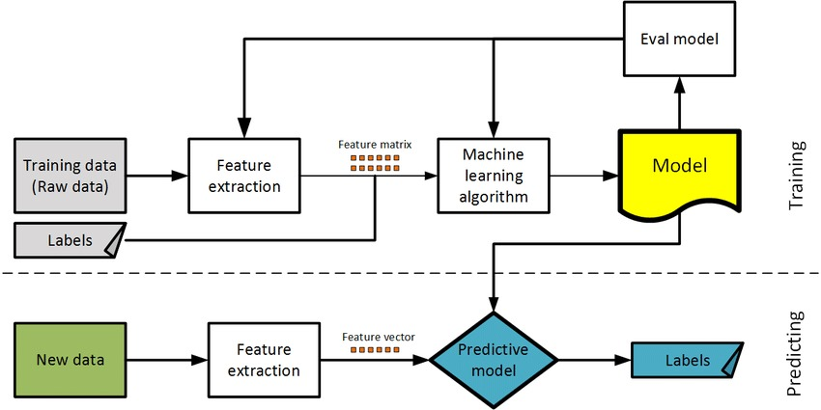
Flow Chart

Slide 7

Key Project Deliverables
Trained Machine Learning Model
A model capable of detecting suspicious behavior with high accuracy.
Research Paper
Research Paper containing all information about model s
used and Detailed Explanation.

Slide 8

Future Scope
1
Improvement in Model
2
Deployment of Model
Improvement with the help of hyper tuning and better selection .
If given Good Accuracy ,deployment of ml model on Cloud.

